Slide 1

SOUR
Cheers to the people who make change.
Spencer Eschyschyn
Paul Thomas
Asif Hasan
Jasleen Kaur
Liz Gilder

Slide 2
Segmentation

Slide 3
Considering startup limitations, SOUR will start its journey in Canada. This is ensuring that our beginning considers both internal company strengths (strong BC roots) and external market factors. Being a startup business, the main decision criteria in deciding an ideal target segment is cost of obtaining the desired data, and potential market growth.
SOUR
Cheers to the people who make change.

Slide 4

Young millennials living in rural areas that are environmentally conscious
Potential Segment #1
Demographic:
Age
Geographic:
Rural
Psychographic:
Environmentalist lifestyle
Segments
Fact 1: The highest consumption of alcohol in Canada is by those ages 18-34 years old at 33.5%, followed by 35-49 years old at 28.4% (McDiarmid, 2019)
Fact 2: Canadians residing in rural areas are more likely to report heavy drinking (22.4%) compared to those living urban areas (18.4%) (McDiarmid, 2019)
Fact 3: 58% of millennials say that they consider sustainability while shopping (Emmert, 2021)
Facts
Demographic:
Adults aged 18-34 years old
Geographic:
Canadians in rural areas
Psychographic:
Those who are environmentally conscious
Target Segmentation
Variables

Slide 5
Young millennials living in rural areas that are environmentally conscious
Potential Segment #1
Demographic:
Age
Geographic:
Rural
Psychographic:
Environmentalist lifestyle
Segments
Fact 1: The highest consumption of alcohol in Canada is by those ages 18-34 years old at 33.5%, followed by 35-49 years old at 28.4% (McDiarmid, 2019)
Fact 2: Canadians residing in rural areas are more likely to report heavy drinking (22.4%) compared to those living urban areas (18.4%) (McDiarmid, 2019)
Fact 3: 58% of millennials say that they consider sustainability while shopping (Emmert, 2021)
Insight: Since the majority of millennials are inherently environmentally conscious and psychographic data is costly to obtain, it is not necessary to strategize using this data.
Facts
Demographic:
Adults aged 18-34 years old
Geographic:
Canadians in rural areas
Psychographic:
Those who are environmentally conscious
Target Segmentation
Variables

Slide 6
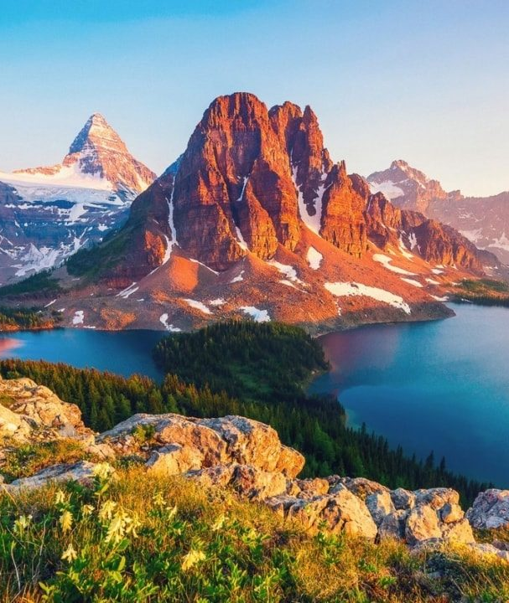
Those located in BC that drink at home
Potential Segment #2
Behavioural:
Convenience
Geographic:
BC
Segments
Fact 1: 20% of Canadians who drink alcohol and have been staying at home more due to the COVID-19 pandemic (Canadian Centre on Substance Use and Addiction, 2020)
Fact 2: Whiskey is the favorite beverage of 20% of British Columbians; this is the highest across the country (Conway, 2020)
Facts
Fact 3: 58% of Canadians drink at home, and 16% at someone else's house for a combined 74% (Boesveld, 2015)
Behavioural:
Those who consume mostly when at home
Geographic:
Those who reside in British Columbia
Target Segmentation
Variables

Slide 7
Those located in BC that drink at home
Potential Segment #2
Behavioural:
Convenience
Geographic:
BC
Segments
Fact 1: 20% of Canadians who drink alcohol and have been staying at home more due to the COVID-19 pandemic (Canadian Centre on Substance Use and Addiction, 2020)
Insight: Considering the costs of obtaining further behavioural data and the fact that the majority of Canadians are at home drinkers, segmenting behaviourally is not necessary for SOUR.
Fact 2: Whiskey is the favorite beverage of 20% of British Columbians; this is the highest across the country (Conway, 2020)
Facts
Fact 3: 58% of Canadians drink at home, and 16% at someone else's house for a combined 74% (Boesveld, 2015)
Behavioural:
Those who consume mostly when at home
Geographic:
Those who reside in British Columbia
Target Segmentation
Variables

Slide 8

Young millennials residing in urban British Columbia
Potential Segment #3
Demographic:
Age
Geographic:
Location and Density
Segments
Fact 1: 14% of Canadians aged 18-34 years old mostly consume mixed drinks or cocktails among all other alcoholic beverages (Forum Research, 2016).
Fact 2: On average, the frequency of alcohol consumption is 17.5% higher in middle-high income Canadians (Conway, 2020)
Facts
Fact 3: Vancouver has a rural-urban income inequality that is 2.5x higher than the national average (Fong, 2017)
Demographic:
Young millennials aged 25-34 align with psychographic variables and the ideal age demographic
Geographic:
Those who reside in urban British Columbia are most likely to enjoy whisky sours
Target Segmentation
Variables

Slide 9

Young millennials residing in urban Alberta
Potential Segment #4
Demographic:
Age
Geographic:
Location and Density
Segments
Fact 1: Calgary has a rural-urban income inequality that is 4x higher than the national average (Fong, 2017)
Fact 2: 48% of Canadians' most common alcohol drinking occasions are when relaxing after work, or working at home, and while watching a sports game (Nationalpost.com, 2015).
Facts
Fact 3: 10% of Albertans say that their favourite drink is whisky; second-highest in the country (Conway, 2020)
Demographic:
Young millennials aged 25-34 align with psychographic variables and the ideal age demographic
Geographic:
Alberta’s urban environment is significantly higher income than the rural demographic; they consume more drinks
Target Segmentation
Variables

Slide 10
Young millennials residing in urban Alberta
Potential Segment #4
Demographic:
Age
Geographic:
Location and Density
Segments
Fact 1: Calgary has a rural-urban income inequality that is 4x higher than the national average (Fong, 2017)
Reasoning to separate BC and Alberta:
When looking at the psychographic traits associated with the differing demographic data in those who reside in BC vs Alberta (for example employment), it is important to have different messaging strategies when it comes to marketing a product.
These differing psychographic traits can include values and opinions and require different marketing messaging and strategies to target.
Fact 2: 48% of Canadians' most common alcohol drinking occasions are when relaxing after work, or working at home, and while watching a sports game (Nationalpost.com, 2015).
Facts
Fact 3: 10% of Albertans say that their favourite drink is whisky; second-highest in the country (Conway, 2020)
Demographic:
Young millennials aged 25-34 align with psychographic variables and the ideal age demographic
Geographic:
Alberta’s urban environment is significantly higher income than the rural demographic; they consume more drinks
Target Segmentation
Variables

Slide 11



Finding the right target segment
Segmentation
Segment #1
Environmentally-conscious millennials
Segment #2
BC at-home drinkers
Segment #3
Urban BC millennials
Segment #4
Urban AB millennials
Core Competency Alignment
*BC-based
*BC-based
Segment Growth Potential
Implementation Feasibility
*data cost is high
*data cost is high
Psychographic data is difficult to obtain, therefor, not conducive to a startups’ environment
Gen-Z’s commitment to sustainability lags millennials; the perception is that it is costly to shop sustainably (Emmert, 2021)
Income inequality between rural and urban environments is continuously rising (Fong 2017)
After establishing a BC base, SOUR can expand easily into its neighbouring province
Additional
Insights

Slide 12
Finding the right target segment
Segmentation
1
2
Segment #1
Environmentally-conscious millennials
Segment #2
BC at-home drinkers
Segment #3
Urban BC millennials
Segment #4
Urban AB millennials
Core Competency Alignment
*BC-based
*BC-based
Segment Growth Potential
Implementation Feasibility
*data cost is high
*data cost is high
Psychographic data is difficult to obtain, therefor, not conducive to a startups’ environment
Gen-Z’s commitment to sustainability lags millennials; the perception is that it is costly to shop sustainably (Emmert, 2021)
Income inequality between rural and urban environments is continuously rising (Fong 2017)
After establishing a BC base, SOUR can expand easily into its neighbouring province
Additional
Insights
Key insight: In order to best align with SOUR’s internal strengths (core competencies), we should prioritize targeting the urban BC millennial segment and also target the the urban Alberta millennial segment

Slide 13
By analyzing the data above we can make insights towards where we should target our consumers by province. With 20% of British Columbians stating their favourite drink is whiskey, this is the largest market. At 10% for Alberta, Western Canada will provide us with the most consumers compared to Eastern Canada. The most likely venue for Canadians to consume alcohol is at their own home or a friends. Since our product comes prepackaged and is designed to be enjoyed at home, targeting consumers who are looking for a premade cocktail to enjoy in the comfort of their own homes is a message we need to convey to our audience. Through targeting the urban millennial demographic within BC and Alberta, we are effectively meeting our psychographic and behavioural criteria, all while remaining within the constraints of our startup model. This marketing model leaves room to expand across the country as the business grows.
SOUR
Cheers to the people who make change.

Slide 14
Targeting

Slide 15
Finding the right target strategy
Segmentation
Undifferentiated
Targeting
Differentiated
Targeting
Concentrated
Targeting
Micromarketing
Targeting
Cost Efficiency
Reachable Audience
Receptiveness
To Message
Targets Multiple Segments
Additional
Insights
Whiskey Sour is a highly niche market
There are multiple segments within the Whiskey Sour niche
Does not consider other market segments within the niche market
Ineffective for small business with widespread audience

Slide 16
Finding the right target strategy
Segmentation
Undifferentiated
Targeting
Differentiated
Targeting
Concentrated
Targeting
Micromarketing
Targeting
Cost Efficiency
Reachable Audience
Receptiveness To Message
Targets Multiple Segments
Additional
Insights
Whiskey Sour is a highly niche market
There are multiple segments within the Whiskey Sour niche
Does not consider other market segments within the niche market
Ineffective for small business with widespread audience
Key insight: Differentiated marketing allows us to be specific and cost efficient with our marketing while also targeting multiple segments of the niche market.

Slide 17
We will use a differentiated targeting strategy as it fits best within our market segment. Whiskey sour is a niche market consisting of people who are passionate about certain aspects of the drink itself. People that enjoy whiskey sour have a particular persona and share certain qualities that can be targeted in our marketing campaign. The cocktail mixer market is approximately 86 billion USD as of 2021. In terms of a resources perspective, differentiated targeting will allow us to effectively penetrate multiple segments simultaneously while keeping ad spend relatively low.
SOUR
Cheers to the people who make change.

Slide 18
Positioning

Slide 19
Sour Pods is looking to position itself not only as a quality cocktail provider for the masses but also as a convenient brand. with innovative, ahead of the curve leader in environmentally friendly packing that their consumers can be proud to use. Its consumers can enjoy their premium cocktail knowing they made an environmental conscious choice while taking in the perfectly proportioned cocktail, every time.
SOUR
Cheers to the people who make change.

Slide 20




Positioning map
Competitor Analysis
Selection Criteria: Environment-friendly, Preparation Time, Retail Price, Convenience to make, Convenience to Buy
Competitor Insights
1
High
SOUR
Competitors packaging is not eco-friendly and relies heavily on the use of plastics. This does not support social and economic trends.
2
Eco-Friendliness
Competitors sacrifice convenience for eco-friendliness - there is a gap in the market for those that offer both.
Low
Creating an eco-friendly, and convenient sour product is an opportunity to differentiate amongst competitors
Low
Convenience
High
20

Slide 21
Positioning Map- Decision Criteria
 | Environment friendly | Preparation Time | Retail Price | Convenience to make | Convenience to Buy
SOUR | 5 | 4 | 5 | 4 | 4
Bartesian | 2 | 4 | 3 | 3 | 2
Dogfish | 1 | 5 | 4 | 4 | 3
Lyre's G+T | 3 | 5 | 2 | 4 | 4
Coit Paradisio | 1 | 4 | 1 | 5 | 2
Sodas | 1 | 3 | 5 | 3 | 5
Reasoning
To understand the competitors better, we ranked them on a scale of 1 to 5. This will help us compare and analyze Sour’s positioning in the market.
5= Excels in the criteria
4= Adopts the criteria
3 = Acknowledges the criteria
2= Relates to the criteria
1= Fails the criteria
Insights: According to our analysis, environment-friendly & convenience rule out to be the top two most important criterias for Sour, when deciding on their positioning strategy in the market.

Slide 22
Reasoning
Positioning Map- Decision Criteria
Environment- Friendly: Sustainability has become a top priority for consumers when making buying decisions. 32% of total alcohol consumers want to engage in adopting an eco-friendly lifestyle (Deloitte, 2021).
Preparation Time: The RTD market has grown 43% globally (Swartz, 2020). People value time and want to know what they’re putting in their body.
Retail Price: Price is important, there’s no doubt in that. A study published by National Institute of Health shows that the brand choice that consumers make while purchasing their beverage, is directly linked to the price offering of the brand (National Institute of Health, 2015)
Convenience to Make: Thanks to the pandemic, now more than ever, the ability to make cocktails from the comfort of your home is in trend. Consumers want to have fun and be adventurous (Swartz, 2020).
Convenience to Buy: Although consumers value price & quality, but in a survey conducted by Smart Insights, 52% respondents said that convenience influences their purchase (Smart Insights, 2020)
POSITIONING STATEMENT: “To whiskey drinkers who are looking for a better mixer than the same old sodas, Sour Pods is a quality mixer that conveniently gives you a quality cocktail in the comfort of your own home, while also allowing you to make environmentally friendly choice over traditional cans or bottles”.

Slide 23
Component 1: Revised

Slide 24



Who are we?
Situational Analysis
“We combine cocktails at home with environmentally friendly packaging.”
Product doesn’t contain any alcohol, only the mixer- allows for us to sell our product anywhere.
We will be using seaweed pods sourced from Ooho, who are based out of Europe. Seaweed is an eco-friendly alternative to current products.
SOUR is a brand new, revolutionary product that addresses a massive market gap.
24

Slide 25
What are our strengths and weaknesses?
Situational Analysis
Internal Strengths
Internal Weaknesses
First company with completely compostable packaging
Cost-efficient business-model
The whiskey-based RTD market is fairly untapped. Whiskey Invest Direct (2020) reports that, “RTD sales volumes will have risen by 43% during 2020 and projects that it will maintain a compound annual growth rate of +21.8% up to 2024”
Cost per-unit will allow for profits to quickly be achieved with minimal sales required
Sour Pods will collaborate with ‘Ooho’, the brand which received a lot of praise for their environmentally-sustainable technology. Therefore, this will add credibility to our company’s name, promote goodwill and start healthy relationship with our target consumer.
It is a start-up business, the recognition and brand presence are nil
Heavy investments required, unsure revenue & many expenses
Extra caution is required to ensure that each batch of Sour Pods meets the North American Health and Food standards
COVID-19 will cause delays in imports of pods from England. A report from Statistics Canada (2021) states that “consumption goods saw a -12.3% decline from just January 2020 to June 2020”
COVID-19 will also affect our services as the shipping of products to customers, might experience delays
Insight: Though there are startup risks, the cost efficient business model, product differentiation, and external industry trends make this a viable business
25

Slide 26
Cost Components
Product Cost Breakdown
Item | Cost
1-ounce lime juice | $0.03 (Walmart.ca)
1-ounce simple syrup | $0.059 (Walmart.ca)
Ooho packaging | $0.002 (Ooho.com)
Delivery (1 ounce) | $0.16
Egg White | $ 0.70
Advertising Ad Cost | $0.35
= $0.801
Insight: Affordable cost components make it easy to penetrate the market with a low price point
Notes:
*The table shows costs components for SOUR PODS for every 1 serving:

Slide 27
Insight: Deeper Dive
Product Costs + TAM consumers estimated sales per capita = With our product costs being under a dollar per unit, we will be able to mass produce Sour Pods at a relatively affordable price. With our TAM consumer predicted to spend $5.45 per capita on RTD whiskey based cocktails, our product will fit right onto that price range and be attractive to our target consumers. By producing an affordable product we also hope to entice trials and gain consumers from outside our traditional whiskey consumers or non-RTD consumers. We aim to use our low product costs to our advantage, and will allow us to scale effectively to our market size as it grows.

Slide 28
What is our market size?
Market Sizing
TAM
FACT: Per capita sales of spirits, Canada, 2019/20 = CA$190.1 (StatCan., 2021)
FACT: Spirits market share of whiskey, Canada, 2019/20 = 29.9% (StatCan., 2021)
= CA$56.84 (-> estimated per capita sales of whiskey, Canada, 2019/20)
FACT: As of June 2016, 14% Canadian of age 18-34 years old mostly consumed mixed drinks or cocktails among all other alcoholic beverages (Forum Research, 2016)
FACT: In the last three years, RTD alcoholic beverages were most often consumed (light) alcoholic beverages in the U.S. And the trend shows that it is becoming more popular in the recent years, with 47% share of respondents in 2020 (WTWH Media, 2021)
SAM
SOM

Slide 29
What is our market size?
Market Sizing
Serviceable Addressable Market (SAM)
Market size = population of Canada * estimated per capita sales
= 38 million * 2.56
= 97.2 million
18-34 years old; otherwise, they would much prefer to drink outside, e.g. at a bar or drink something better
Likes mixed drinks and cocktails
Also likes to drink whiskey
Finally, has a preference for RTD alcoholic beverage
TAM
SAM
SOM
Constraints:
Estimated per capita sales of whiskey infused mixed drinks or cocktails, Canada, 2019/20 = 56.84 * 14%
= CA$7.96
Now, estimated per capita sales of RTD whiskey drinks, Canada 2019/20 = 7.96 * 47%
= CA$3.74

Slide 30
What is our market size?
Market Sizing
TAM
SAM
FACT: Annual CPI of non-alcoholic beverages in Canada in 2020 was 130.3 (StatCan., 2021)
68.5% of per capita sales of spirits, Canada, 2019/20
Now, we will use the ratio of CPI of non-alcoholic beverages (2020) and per capita sales of spirits to calculate the estimated per capita sales of sour pods in Canada.
Estimated per capita sales of sour pods = 3.74 * 68.5% = CA$2.56
SOM

Slide 31
What is our market size?
Market Sizing
Total Addressable Market (TAM)
For our TAM consumers, we can define them without the constraint of having preference for RTD beverages. This is because RTD alcoholic beverages are a fairly new category of alcoholic beverages and its popularity is expected to increase in coming years.
Estimated per capita sales of sour pods = 7.96 * 68.5%
= CA$5.45 (more than double of SAM)
TAM
SAM
SOM

Slide 32
What is our market size?
Market Sizing
Serviceable Obtainable Market (SOM)
For our SOM consumers, we can define them by adding additional constraints to our existing SAM constraints. One such could be that our consumers are mostly likely to drink sour pods at their home or some other specific settings
FACT: As of 2015, most common alcohol drinking occasions among Canadians are:
In the first rank, ‘consumed when relaxing/after work/ working around home’ which is our more specific target consumer- 27% (Nationalpost.com, 2015)
FACT: In the second rank, ‘while watching a game’, also our target consumer that we want to incorporate - 21% (Nationalpost.com, 2015)
Therefore, estimated per capita sales of sour pods = 2.56 * 48%
= CA$1.23 (more than about half of SAM)
TAM
SAM
SOM

Slide 33
What are some industry trends we can address?
Industry Analysis
FACT: Alcohol ecommerce grew by more than 40% in 2020
Opportunity to establish ourselves in a relatively new online marketplace for at home cocktails
Few competitors in this space

Slide 34


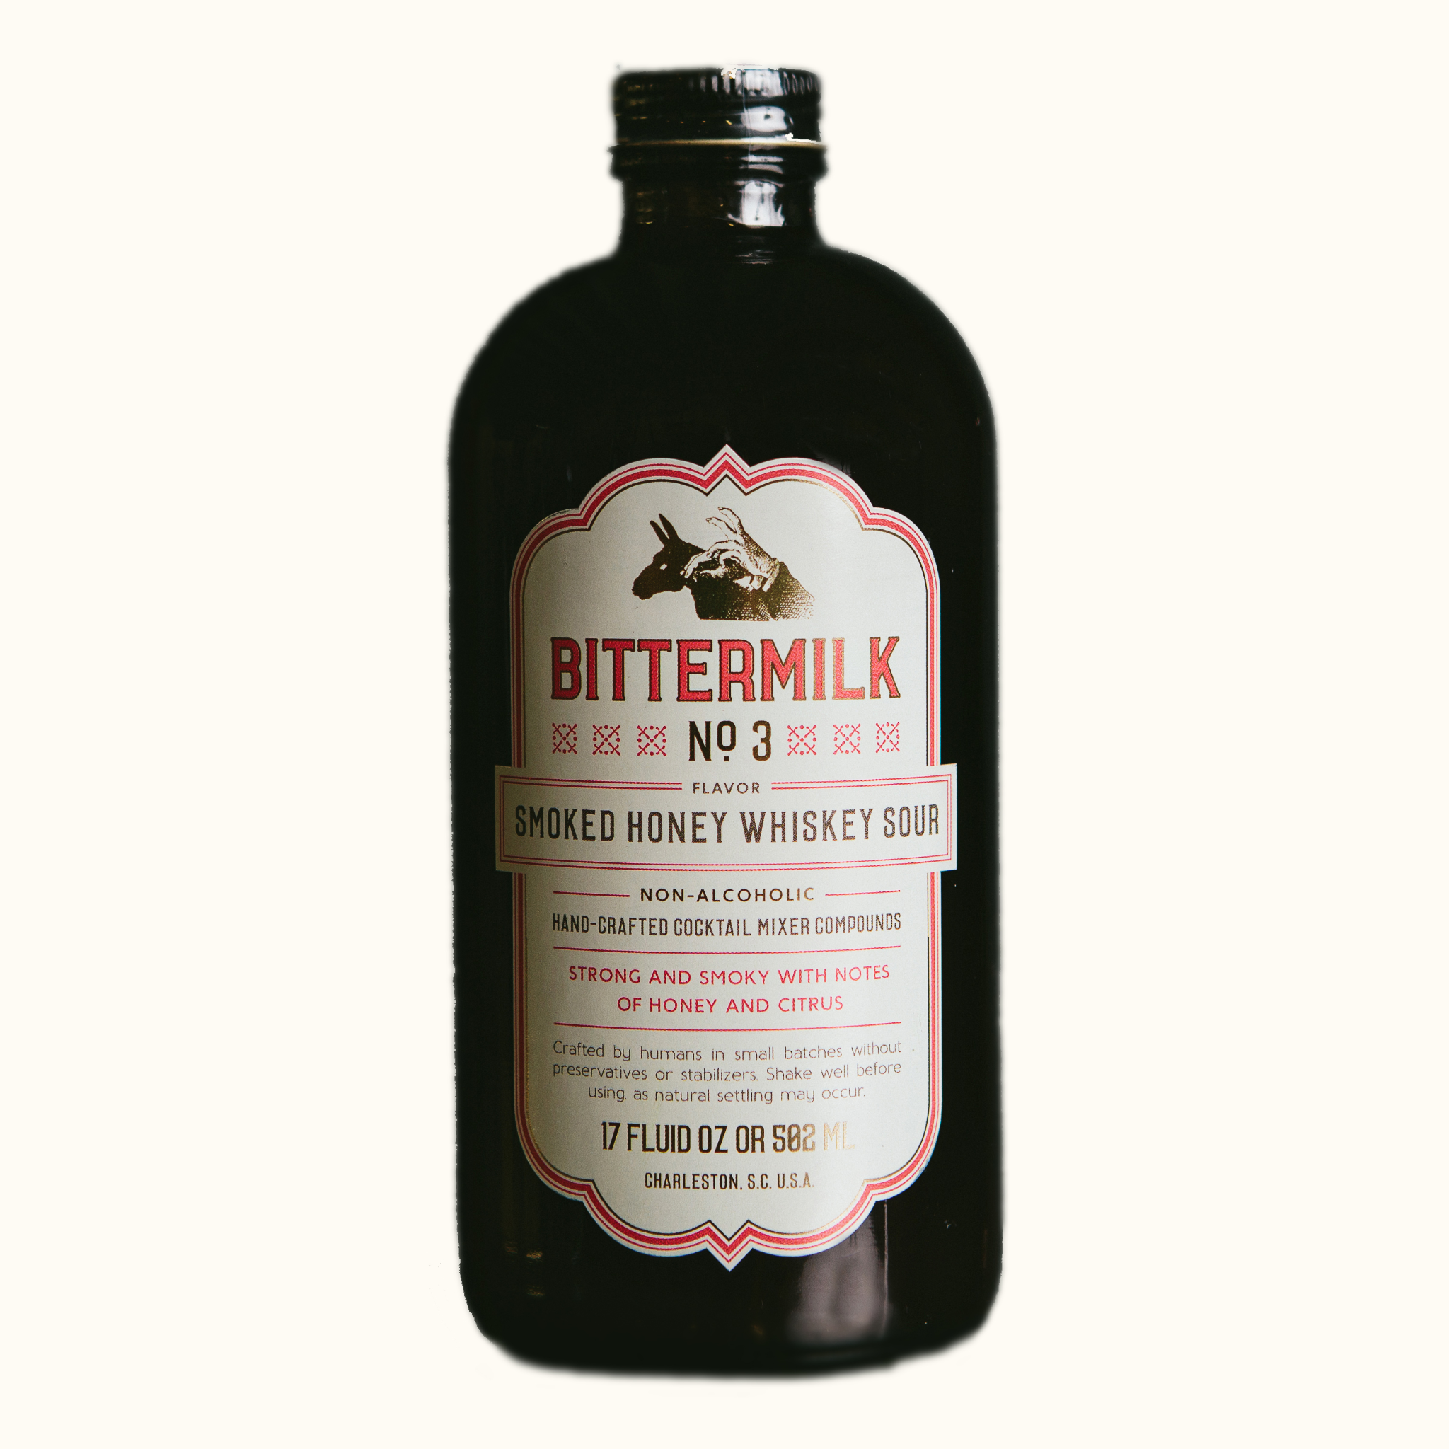

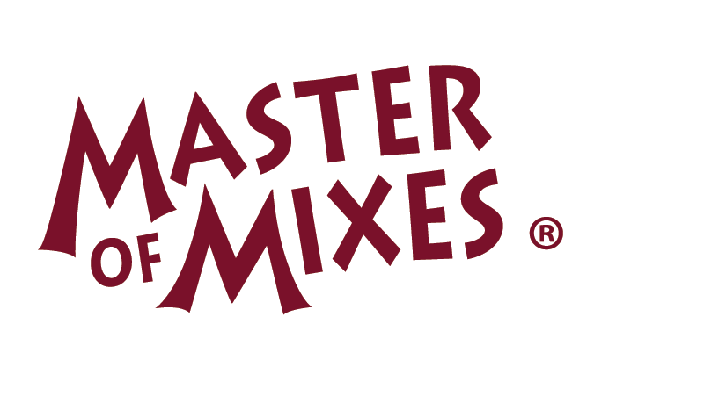
Who are our competitors?
Competitor Analysis
Selection Criteria: Comparable size, Value proposition, Mission alignment , Location
Competitor Insights
1
High
Other whiskey sour pods require the use of a cocktail machine to serve
2
Eco-Friendliness
Competitors packaging is not eco-friendly and relies heavily on the use of plastics. This does not support social and economic trends
Low
Creating a low-price, eco-friendly sour product is a strong differentiator amongst competitors
Low
Price Point
High
34

Slide 35
Case Study: Mr. and Mrs. T
Competitor Analysis
Mr & Mrs T offer a cheap low quality whiskey sour mixer that would be targeted to either first time consumers of the cocktail or those looking for a cheap mixer that resembles the taste of a whiskey sour. Their packaging is not environmentally friendly as it is sold in a plastic bottle and long term storage is questionable after the bottle is unsealed. One of the great benefits of our whiskey sour is that we use capsules (or pods) to preserve the flavour in each serving.

Slide 36
Case Study: Mr. and Mrs. T
Competitor Analysis
The Bartesian Whiskey Sour Cocktail Mix is our closest competitor since they offer a relatively high quality whiskey sour served in capsules. We believe that by sourcing our ingredients overseas we will be able to offer a high quality product and position ourselves at the top end of the market. Our pods will also be compatible with all cocktail mixers this way we can still target our competitors customers without forcing them to purchase new equipment.

Slide 37
Speculative Assumptions and Insights (CDSTEP)
Competitor Analysis
Pods are still a new concept in the alcohol industry however advancements in technology have allowed us to offer a longer lasting and better tasting whiskey sour than our by-the-bottle competitors
Shifts in social and economic trends have put an emphasis on preserving the environment and that is why part of our mission with our whiskey sour pods concept is to offer a sustainable and eco-friendly alternative to plastic bottles
By establishing ourselves as an ecommerce business, we will be able to get a solid foothold in the current market as we can cast a wider net to our target market
We also plan on capitalizing on the impact of COVID-19 by positioning ourselves as a restaurant style cocktail served at home.

Slide 38
Insight: Partnership with Ooho
Partnership with Ooho + Competitors lack of environmentally-friendly packaging = By partnering with Ooho, we have been able to make Sour Pods a completely biodegradable product, leaving no waste behind for future generations. None of our competition offer this, mainly using plastics or glass for their packaging. With the socio-economic trends shifting towards green solutions, we see this as an amazing opportunity to be a market leader. By having this distinct advantage, this is most definitely a factor we will be promoting during our marketing campaign.

Slide 39
Cheers.

Slide 40
References
Barton, J. (2019). How Much Do Instagram Ads Cost. SEO Resellers Canada. Retrieved from https://seoresellerscanada.ca/how-much-do-instagram-ads-cost/
Barton, J. (2019). Your Guide to YouTube Ads: How Much Does YouTube Advertising Cost. SEO Resellers Canada. Retrieved from https://seoresellerscanada.ca/your-guide-to-youtube-ads-how-much-does-youtube-advertising-cost/
Bedford, E., (2019, November 28). Domestic Beer Consumption Canada Age Group 2019. Statisa. https://www.statista.com/statistics/339801/beer-consumption-in-canada-by-gender-and-age-group/
Boseveld, S. (205, May 15). How we drink: Here's everything you need to know about Canadians' overall boozy habits. National Post. https://nationalpost.com/life/how-we-drink-from-how-much-to-how-often-heres-everything-you-need-to-know-about-canadians-boozy-habits
Canadian Centre on Substance Use and Addiction. (2020, June 9). More than 1 in 5 Canadians who drink alcohol and have been staying at home more have been drinking once a day since the beginning of May. GlobeNewswire News Room. Retrieved November 9, 2021, from https://www.globenewswire.com/en/news-release/2020/06/09/2045685/0/en/More-than-1-in-5-Canadians-who-drink-alcohol-and-have-been-staying-at-home-more-have-been-drinking-once-a-day-since-the-beginning-of-May.html.

Slide 41
References
Conaway, J. (2020, December 1). Total Alcohol Consumption in Canada. Statista. https://www.statista.com/topics/2998/alcohol-consumption-in-canada/
Crandall, P.G., Mauromoustakos, A., O’Bryan, C.A., Thopmson, K.C., Yiannas, F., Bridges, K., Francois, C. (2017). Impact of the Global Food Safety Initiative on Food Safety Worldwide: Statistical Analysis of a Survey of International Food Processors. Journal of Food Projection. 80(10). 1613-1622.
https://doi.org/10.4315/0362-028X.JFP-16-481
Emmert, A. (2021, July 8). The rise of the eco-friendly consumer. strategy+business. Retrieved November 9, 2021, from https://www.strategy-business.com/article/The-rise-of-the-eco-friendly-consumer.
Forum Research. (June 8, 2016). Type of alcoholic beverage most commonly consumed by adults in Canada as of June 2016, by age group [Graph]. In Statista. Retrieved November 09, 2021, from https://www-statista-com.proxy.lib.sfu.ca/statistics/587682/alcoholic-beverage-most-consumed-canada-by-age/
Fong, F. (2017). Income Inequality in Canada: The Urban Gap. Retrieved November 10, 2021, from file://Downloads/G10363-SC_Income%20Inequality%20in%20Canada%20-%20The%20Urban%20Gap_FINAL_ENG.pdf.

Slide 42
References
Ipsos. (2015, May). Alcohol: drinking occasions in Canada 2015. Statista. Retrieved November 9, 2021, from https://www-statista-com.proxy.lib.sfu.ca/statistics/434629/alcohol-drinking-occasions-among-canadians/. Jan Conway, & 24, N. (2020, November 24). Favorite alcoholic beverages canada by province 2018. Statista. Retrieved November 9, 2021, from https://www.statista.com/statistics/896012/favorite-alcoholic-beverages-canada-by-province/.
Katen, E., Turner, N. (2019, March 26). New immigrants made up 61% of Canada’s population growth in 2018. CIC News.https://www.cicnews.com/2019/03/new-immigrants-made-up-61-of-canadas-population-growth-in-2018-
Ltd, M. D. (n.d.). Smoothies Market Size, Share, Trend Analysis: North America: Europe: APAC: MEA: LA. Retrieved from https://www.marketdataforecast.com/market-reports/smoothies-market
McDiarmid, C. (2019, June 25). This is a health fact sheet about heavy drinking habits among Canadians aged 12 and older. the results shown are based on data from the Canadian Community Health Survey. Heavy Drinking, 2018. Retrieved November 9, 2021, from https://www150.statcan.gc.ca/n1/pub/82-625-x/2019001/article/00007-eng.htm.

Slide 43
References
National Institute of Health. (November, 2015). Retrieved from https://www.ncbi.nlm.nih.gov/pmc/articles/PMC4192130/
NielsonIQ. (2019, May 21). How newer ready-to-drink beverages and packages are shaking up the adult beverage market. https://nielseniq.com/global/en/insights/analysis/2019/how-ready-to-drink-beverages-and-packages-are-shaking-u p-the-adult-beverage-market/
Ready-to-Drink Cocktails are Growing Fast. (2018, July 6). The Algoma News Review. http://www.thealgomanews.ca/ready-to-drink-cocktails-are-growing-fast
The Pricer. (2016, May 23.). Ohoo the edible water bottle or bubble cost. https://www.thepricer.org/ooho-the-edible-water-bottle-or-bubble-cost/
Spirits Canada. (2019, January 21). Spirits show strong growth in Canada in 2018. https://www.restobiz.ca/spirits-show-strong-growth-canada-2018/
StatCan. (May 31, 2021). Sales value of alcoholic beverages per capita in Canada in 2019/20, by type (in Canadian dollars) [Graph]. In Statista. Retrieved November 09, 2021, from https://www-statista-com.proxy.lib.sfu.ca/statistics/710186/sales-share-of-the-alcoholic-beverages-canada/

Slide 44
References
Statistics Canada. (2021). Impact of COVID-19 on merchandise imports: evidence based on end-use good. Retrieved from https://www150.statcan.gc.ca/n1/pub/13-605-x/2021001/article/00001-eng.htm
StatCan. (May 4, 2021). Market share of spirits in Canada in 2019/2020, by category and region [Graph]. In Statista. Retrieved November 09, 2021, from https://www-statista-com.proxy.lib.sfu.ca/statistics/1265085/spirits-market-share-by-type-and-region-canada/
Smart Insights. (2020). Convenience is driving e-commerce growth and influencing consumer decisions. Retrieved from https://www.smartinsights.com/ecommerce/convenience-is-driving-e-commerce-growth-and-influencing-consumer-decisions/
StatCan. (February 2, 2021). Annual consumer price index (CPI) of non-alcoholic beverages in Canada from 2003 to 2020 [Graph]. In Statista. Retrieved November 09, 2021, from https://www-statista-com.proxy.lib.sfu.ca/statistics/437520/cpi-of-non-alcoholic-beverages-canada/
Smart Insights. (2020). Convenience is driving e-commerce growth and influencing consumer decisions. Retrieved from https://www.smartinsights.com/ecommerce/convenience-is-driving-e-commerce-growth-and-influencing-consumer-decisions/

Slide 45
References
StatCan. (February 2, 2021). Annual consumer price index (CPI) of non-alcoholic beverages in Canada from 2003 to 2020 [Graph]. In Statista. Retrieved November 09, 2021, from https://www-statista-com.proxy.lib.sfu.ca/statistics/437520/cpi-of-non-alcoholic-beverages-canada/
Sustaina. (2018, September 21). Rethink your drink with water capsules. Global Opportunity Explorer. https://goexplorer.org/edible-water-capsules/
Swartz, K. 2020). COVID-19 is Fueling a Home Mixology Movement. Retrieved from https://beveragedynamics.com/2020/08/03/covid-19-home-mixology-cocktails/
Swartz, K. (2020). Why RTDs Will Boom in 2021 and Beyond. Retrieved from https://beveragedynamics.com/2020/11/19/rtds-canned-cocktails-trends-growth-2021/
Vencat, E. (2020, October 19). Top 10 Diet Trends for 2021. Retrieved from https://youbars.com/blogs/news/top-10-diet-trends-for-2021

Slide 46
References
Website (nationalpost.com). (May 15, 2015). Most common alcohol drinking occasions among consumers in Canada as of May 2015 [Graph]. In Statista. Retrieved November 09, 2021, from https://www-statista-com.proxy.lib.sfu.ca/statistics/434629/alcohol-drinking-occasions-among-canadians/
Walmart.com. Retrieved from https://www.walmart.com/ip/Mr-Mrs-T-Bold-Spicy-Bloody-Mary-Mix-1-75-L-bottle/36300569
Woodard, R. (2020). Scotch & RTDs: The Time is Now. Whiskey Invest Direct. Retrieved from https://www.whiskyinvestdirect.com/whisky-news/scotch-rtd-112020201
WTWH Media. (March 29, 2021). Most often consumed ready-to-drink alcoholic beverages in the U.S. from 2018-2020 [Graph]. In Statista. Retrieved November 09, 2021, from https://www-statista-com.proxy.lib.sfu.ca/statistics/1232410/rtd-alcoholic-beverage-consumption-us/

